Slide 1

Diabetes Prediction
Deepika Vemu
Pragati Khanna
Akshith Mashetty
Harish Gurrapu
Coby Mccaig
Avinash Rajendran

Slide 2
INTRODUCTION
Today, we're excited to share a sneak peek into our recent deep dive into the world of healthcare analytics. Our team has been on a mission, partnering with a diabetes endocrinology center to extract valuable insights from a dynamic dataset.
As data management experts, our focus is on extracting actionable intelligence from the dataset to empower healthcare professionals and institutions. The dataset encompasses a range of medical and demographic attributes, providing a rich foundation for our analysis. Join us as we delve into our findings, potential business tasks, and the compelling argument for extending our contract. Let's embark on a journey through the intricate web of diabetes analytics and discover how our work can revolutionize healthcare practices.

Slide 3
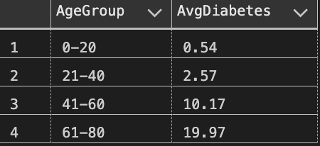
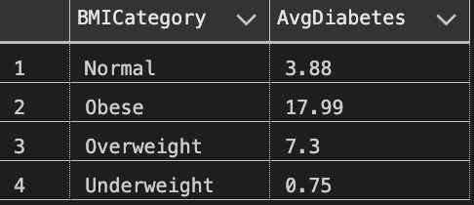
SUMMARY QUERIES
Patient Data Analysis:
Categorizes patient data by age group and BMI category.
Computes average diabetes by age group, and BMI.
Key Insights:
The higher the patient's age, the more likely they are to have diabetes and the average diabetes value is highest for patients who are obese.

Slide 4

USER-DEFINED FUNCTION (UDF)
Function Name: fn_GetDiabetesRiskCategory
Purpose: Categorizes diabetes risk based on BMI and age.
Output: Provides a risk category (e.g., Low, Moderate, High) for healthcare assessment.
Diabetes Risk Assessment:
Utilizes BMI and age to classify into risk categories (e.g., Low, Moderate, High).
Aids personalized evaluation for healthcare professionals in determining patient risk levels

Slide 5
STORED PROCEDURE
Stored Procedure: sp_GetPatientDiabetesStatus
Outcome: Provides detailed patient health and diabetes status for a specific ID.
Usage: Execute with patient ID (e.g., 2525) for a quick, comprehensive health snapshot.

Slide 6
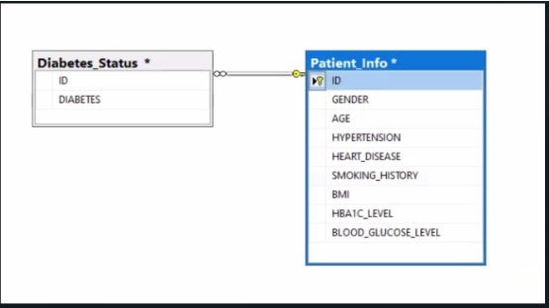
ERD
Impact in Healthcare Project:
Enhanced Patient Care
Cost Reduction
Improved Disease Tracking
Benefits for the Company:
Improved Data Organization
Reduced Errors & Redundancy
Enhanced Collaboration & Security

Slide 7
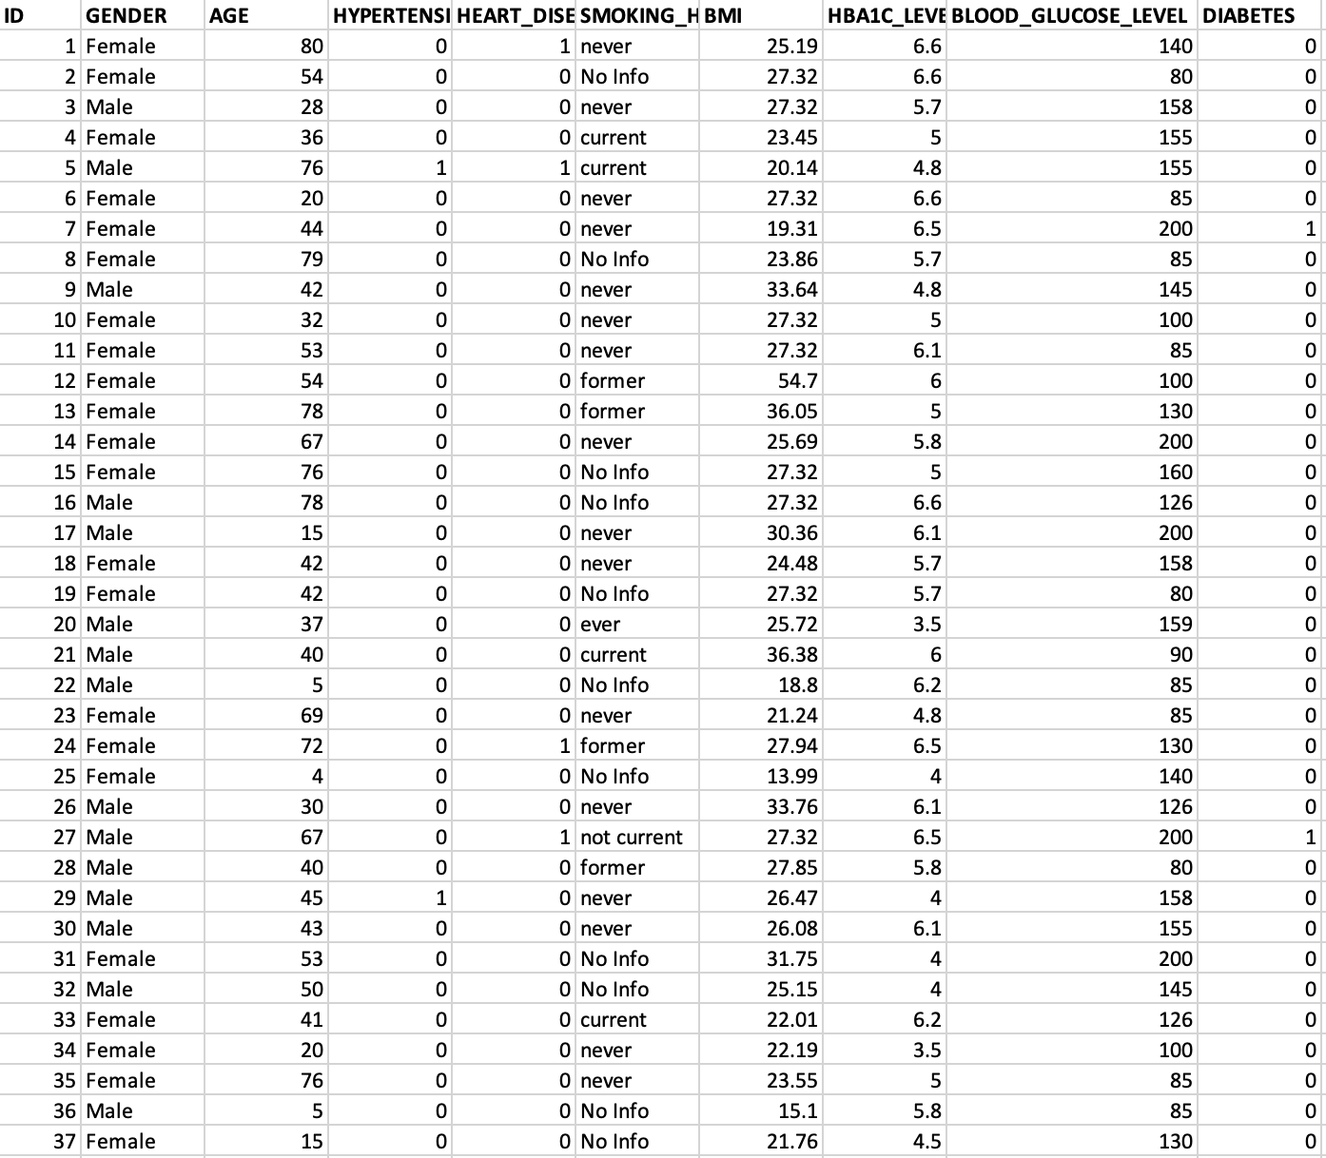

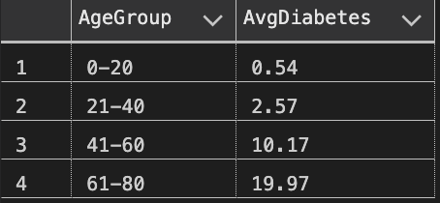
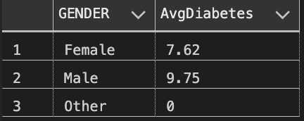
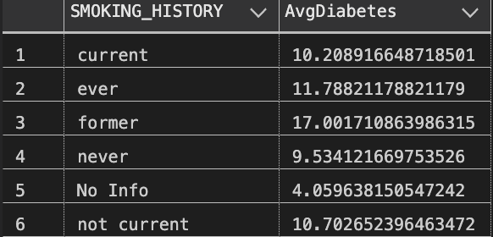
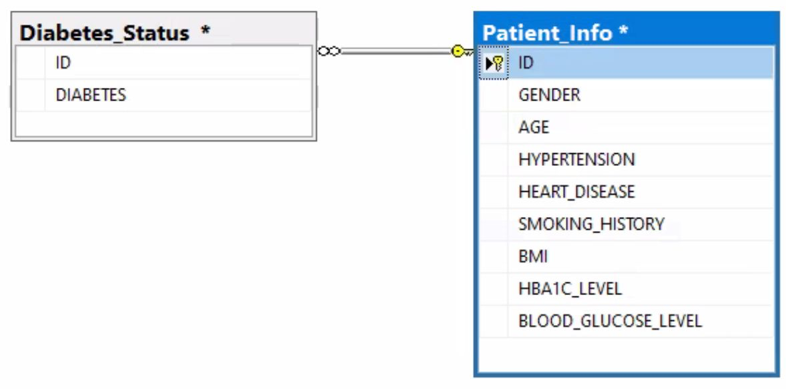
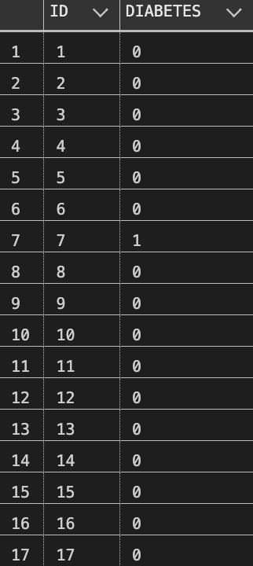
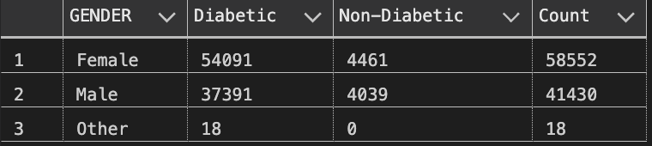
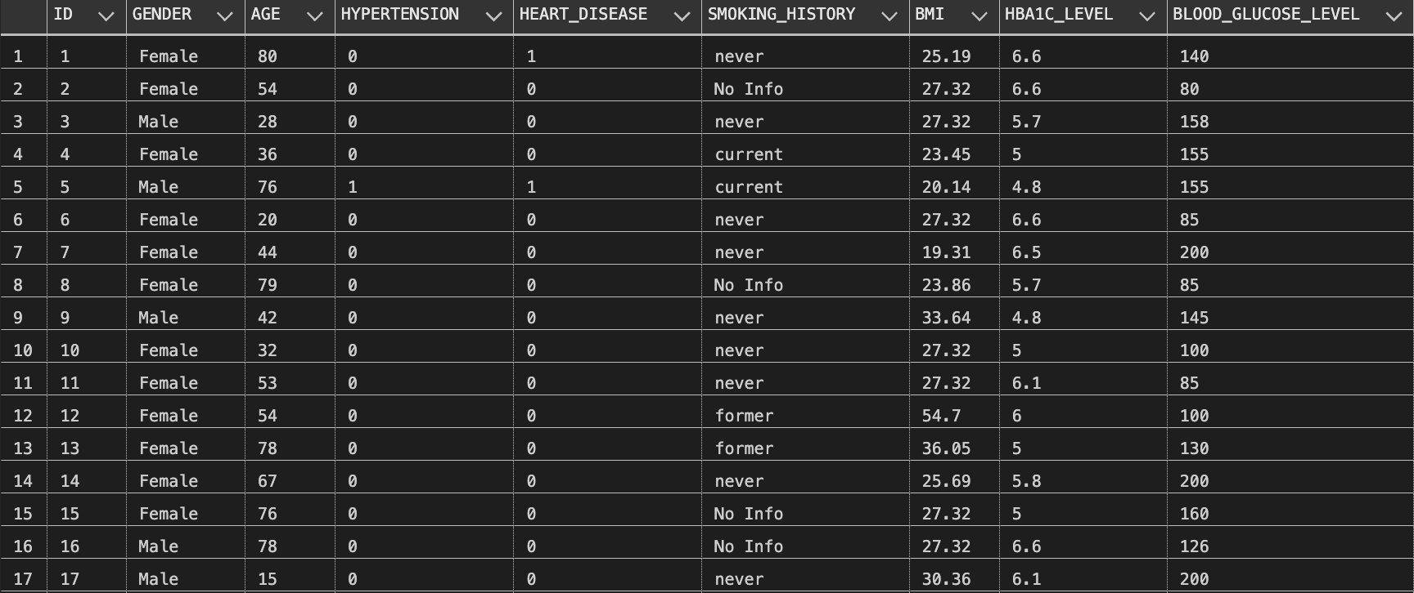
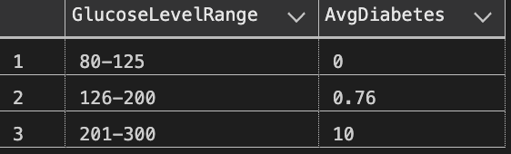
DASHBOARD

Slide 8
POTENTIAL BUSINESS TASKS
Risk Identification:
Provide healthcare professionals with insights to identify individuals at the highest risk of developing diabetes.
Personalized Treatment Plans:
Facilitate the creation of personalized treatment plans based on informed data analysis, enhancing patient care.
Preventive Approaches:
Support the adoption of new preventive approaches to minimize the occurrence of diabetes cases.
Patient Education:
Empower healthcare professionals to educate patients on primary medical and demographic factors related to diabetes risk.
Endocrinology Center Focus:
Encourage endocrinology centers to prioritize and integrate identified factors into their practices for proactive patient care.
Public Awareness:
Foster patient awareness by highlighting key factors to look out for in preventing or coping with diabetes.

Slide 9
Convincing Argument
Crucial Insights for Healthcare Providers:
Our analysis provides vital insights into diabetes risk factors, empowering healthcare providers with a deeper understanding of patient health.
Personalized Treatment Plans:
Devising personalized treatment plans becomes possible, improving patient care by addressing specific health needs.
Proactive Measures for Endocrinology Centers:
Endocrinology centers can proactively address potential diabetes cases by prioritizing primary medical and demographic factors.
Patient Education and Preventive Measures:
Educate patients on preventive measures by highlighting key risk factors, fostering a patient-centric approach to diabetes management.
Empowering Healthcare Centers:
Empower healthcare centers, especially endocrinology clinics, with effective strategies for diabetes prevention and management.
Continued Support through Contract Extension:
Extension of our contract ensures sustained support, optimizing healthcare practices and fostering proactive patient-centric approaches for long-term success.

Slide 10
CLOSING
Our exploration into the diabetes dataset has unveiled crucial insights that can significantly impact healthcare practices.
The positive correlation between age, glucose levels, and diabetes, along with the influence of factors like obesity and past smoking, emphasizes the need for targeted preventative measures.
By leveraging these findings, healthcare professionals can tailor treatment plans, spreading awareness, and adopting new preventive approaches.
This dataset serves as a foundation for developing well-structured machine-learning models, fostering a proactive and personalized approach to diabetes prevention.

Slide 11
FUTURE RESEARCH
Longitudinal Analysis:
Conduct a longitudinal analysis to track changes in patients' health conditions over time.
Gain insights into the evolution of factors and their long-term impact on diabetes risk.
Integration of External Data:
Explore the integration of external datasets, such as genetic information or lifestyle data.
Enhance the accuracy and comprehensiveness of the analysis by incorporating additional relevant data.
Regional Variances:
Investigate potential regional variations in diabetes prevalence and associated risk factors.
Tailor strategies for diabetes prevention and management based on region-specific findings.

Slide 12
REFERENCE
Mustafa, Mohammed. “Diabetes Prediction Dataset.” Kaggle, 8 Apr. 2023, www.kaggle.com/datasets/iammustafatz/diabetes-prediction-dataset.

